Slide 1




GENOMIC LLMS IN PRACTICE
A Hands-On Introduction With Huggingface
Workshop Briefing
by Megha Hegde, Shashank Ravichandran, Jean-Christophe Nebel, Ragothaman Yennamalli, Farzana Rahman

Slide 2
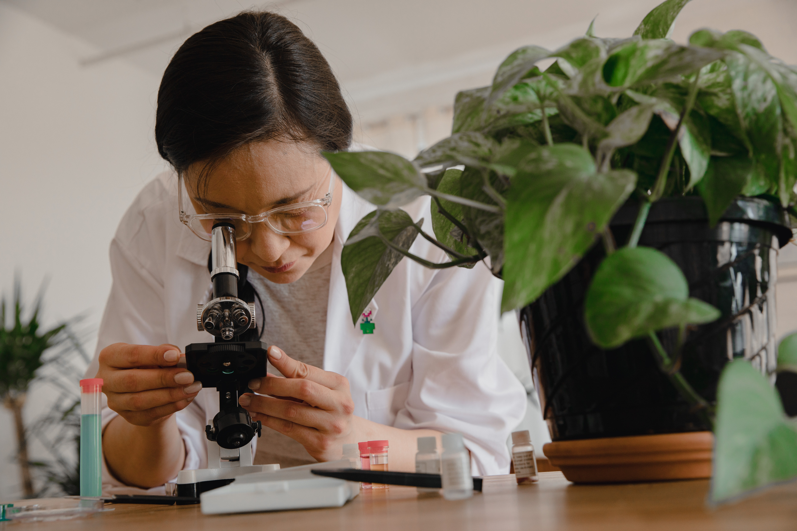
TASK 1: FINE-TUNING TINYDNABERT
Open the following Google Colab notebook: https://github.com/meghegde/genomic-llms-in-practice/blob/main/Workshop/Exercise_Finetuning.ipynb
Follow the instructions and fill in the blanks to fine-tune TinyDNABERT.
2

Slide 3
TASK 2: FINE-TUNING NUCLEOTIDE TRANSFORMER + INTERPRETING EMBEDDINGS
Open the following Google Colab notebook: https://github.com/meghegde/genomic-llms-in-practice/blob/main/Workshop/Exercise_genomic_llm_embeddings_and_interpretability.ipynb
Follow the instructions and fill in the blanks to perform fine-tune Nucleotide Transformer and interpret the embeddings.
3

Slide 4
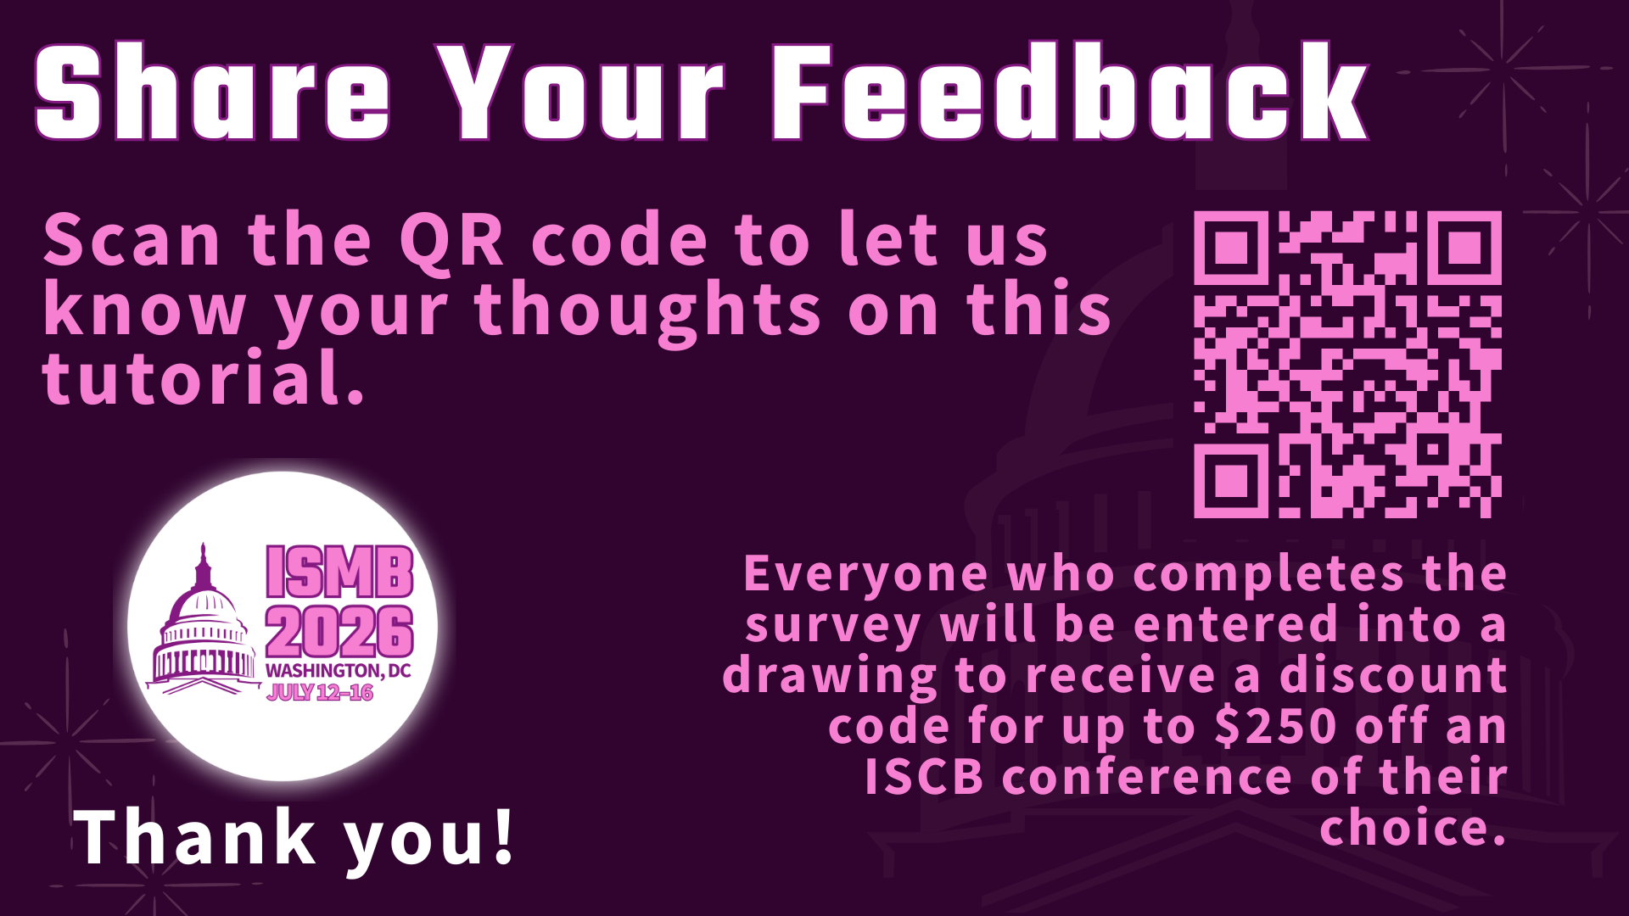
4

